Slide 1


EN1070 – Electronic Product Design and Manufacture
Design Project – Progress Review
Team Tesla
Samal Punsara - 190481G
Rajitha Wanshika - 190663R
Oshani Wansooriya - 190664V

Slide 2
Problem Description
Why
Single
Axis
Tracker
Why
Dual
Axis
Tracker
The sun travels through 360 degree east to west per year and 46 degree north and south per year.
solar panels are in fixed orientation between east and west there is a 75-degree motion in each ide is the day
north-south motion there is a 23-degree motion in each side per day
40% energy lost in day and evening time periods.
8.3 % efficiency lose per day and 5% averaged lose per year.

Slide 3
Problem Description
We cannot predict cloud covering per day
Variation of the distance travel by Sun
Decrease efficiency up to 15%-22% .
Most of the energy will be lost in a conventional fixed solar panel.

Slide 4

Motivation
37% of global electricity production comes from low carbon sources.
Other 63% comes from the fossil fuels such as coal, gas, and oil.
nearly 2/3 of global electricity production is done by high carbon emission sources.
Need a
Solution
Global warming
serious negative impact on the climate changes.

Slide 5



Why Solar Tracking System Need
average the earth surface receives about 604 W/m2 of solar energy
Lack of the efficiency and the cost of the fixed solar panels
3% of global electricity production due to solar panels
Free Energy Source
Convert into Tracking system
Will increase the performance of solar panel up to 30% - 40%

Slide 6
Simplicity Of Operation
Only Need to Supply power to the system
5V input Voltage need
Fully Automated System
User Friendly product
Can Connect to Domestic Electricity supply by using an Adapter
9V batter needed for simple usage

Slide 7

Technical feasibility
Weight of the design is minimum.
Be easy to assemble .
Store the energy that we can use power for a long time period.
Low Power consumption.
Supply at least 10% more energy efficiency than a conventional fixed solar panel.

Slide 8
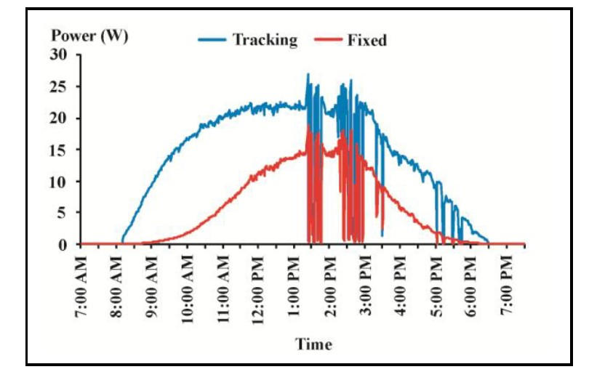
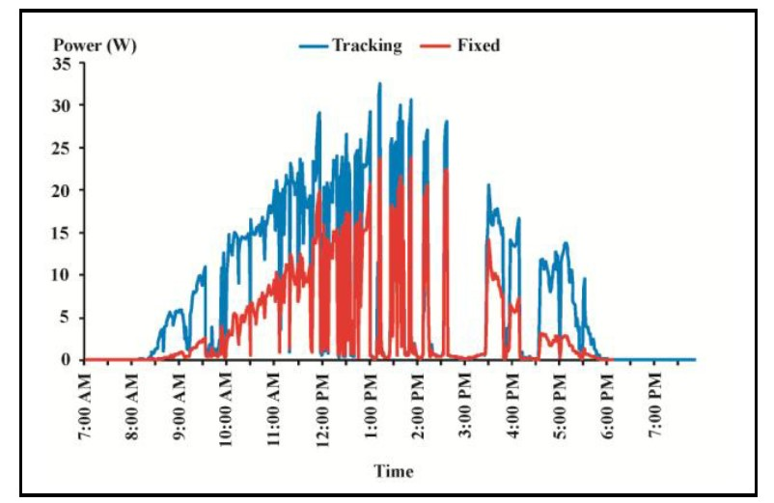
Power feasibility
Increase of Power generation
Low power consumption
Clear Day
Rainy Day ( Estimated )

Slide 9
Product Architecture
Mechanical Structure
Electrical Structure
Panel carrier.
Control unit
Software's used
Panel carrier rotator and holder.
Solidswork
Easy EDA
Microchip Studio
Sensor unit
PCB and battery cover and holder
Movement unit
Power and converter unit

Slide 10
Technical Specifications
Recommend for;
Street lighting
Garden lighting
Portable solar charger
Domestic power supply
( Need to increase the number of Panels, inverter system for domestic electric usage – As per the customer order )
increase the performance of solar panel up to 30% - 40%
Warranty terms
2 Years for full product warranty for manufacture defects.
3 Years for service warranty.
15 Years warranty for solar panel.( T/C apply)

Slide 11
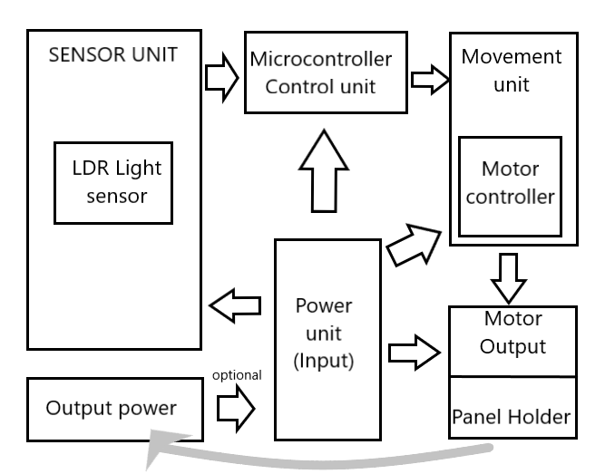
Product Architecture
Block Diagram

Slide 12

Enclosure Design

Slide 13

Enclosure Design

Slide 14
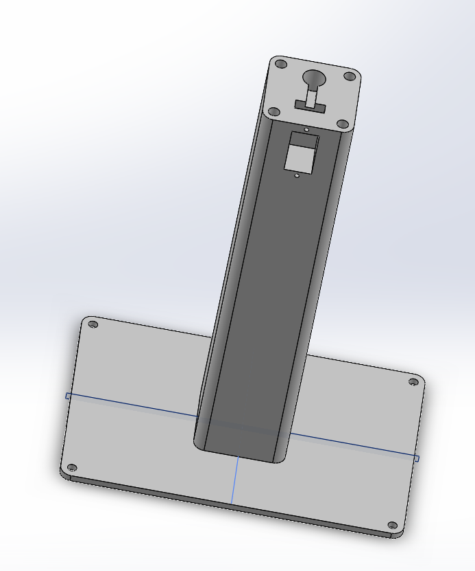
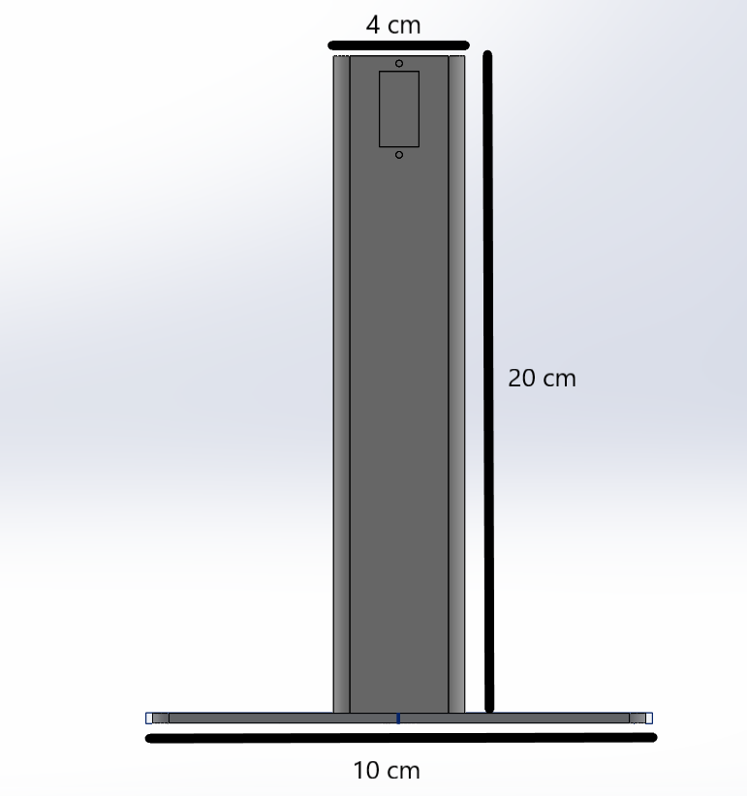
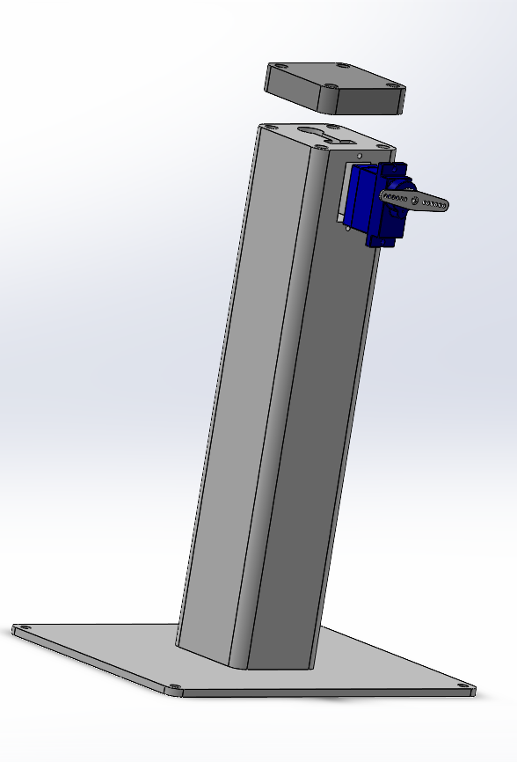
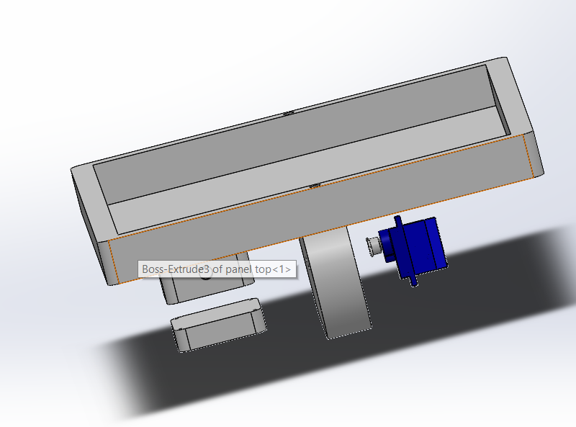
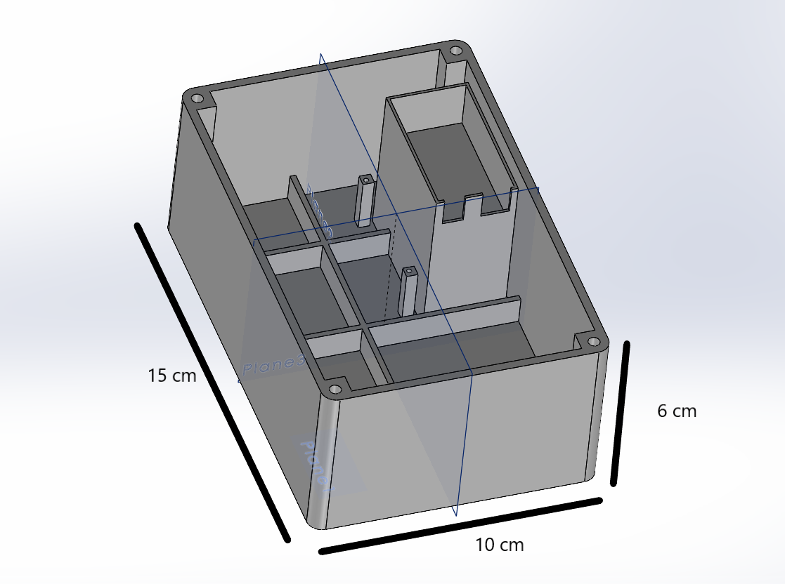
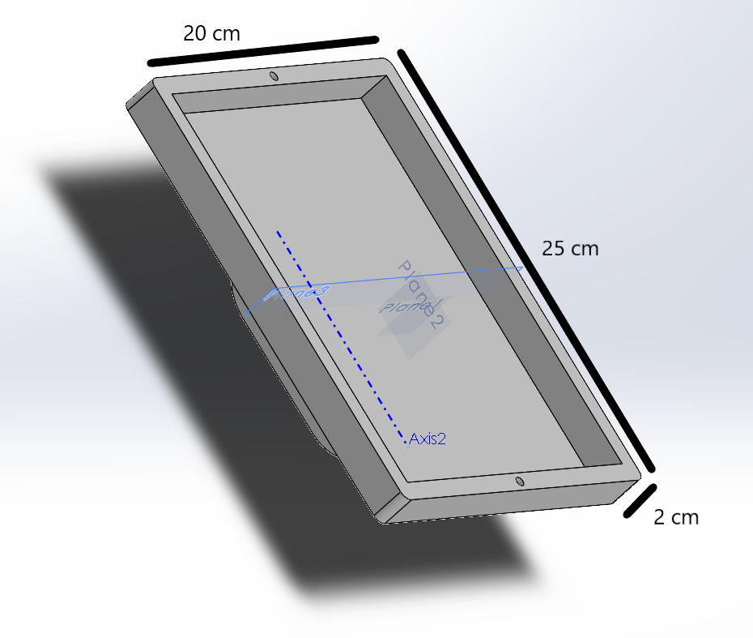
Enclosure Design

Slide 15
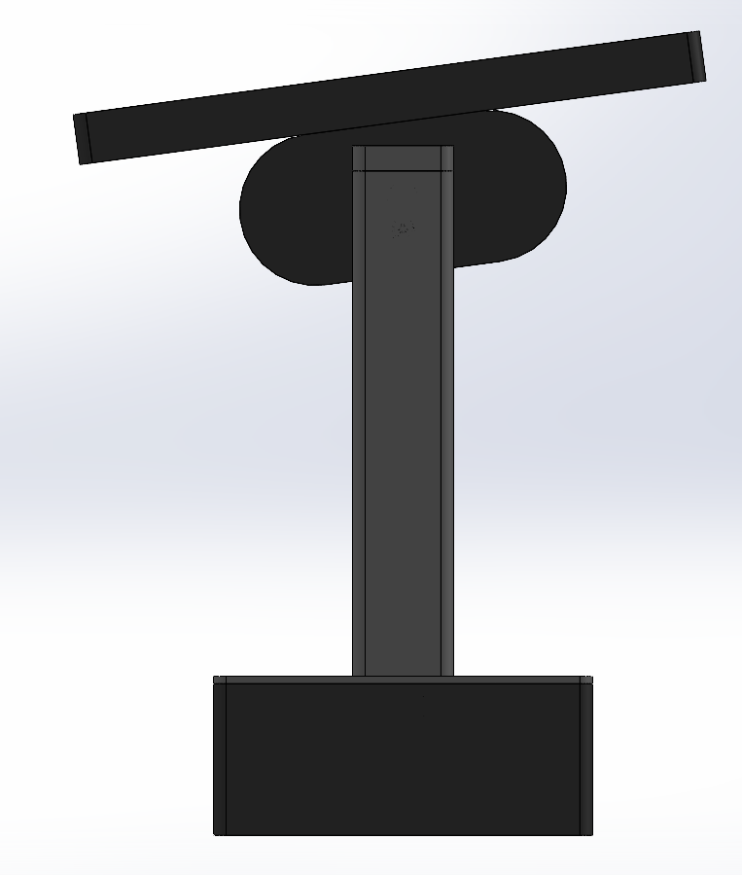
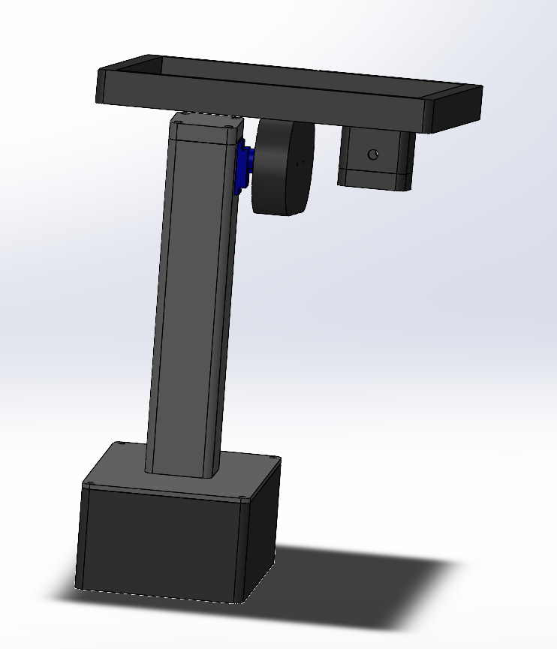
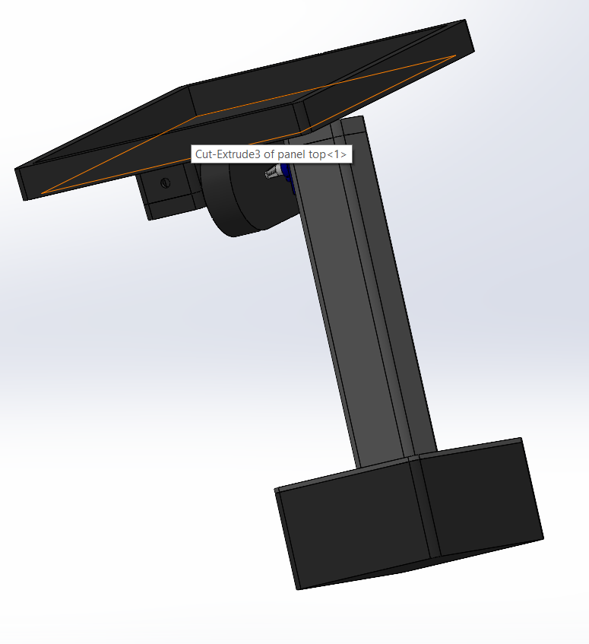
Enclosure Design
*Estimated weight 250 g – 400 g. ( Without solar panel and the inverter ).
( this is the weight for portable solar tracking system. This may be varying by the order request.)

Slide 16
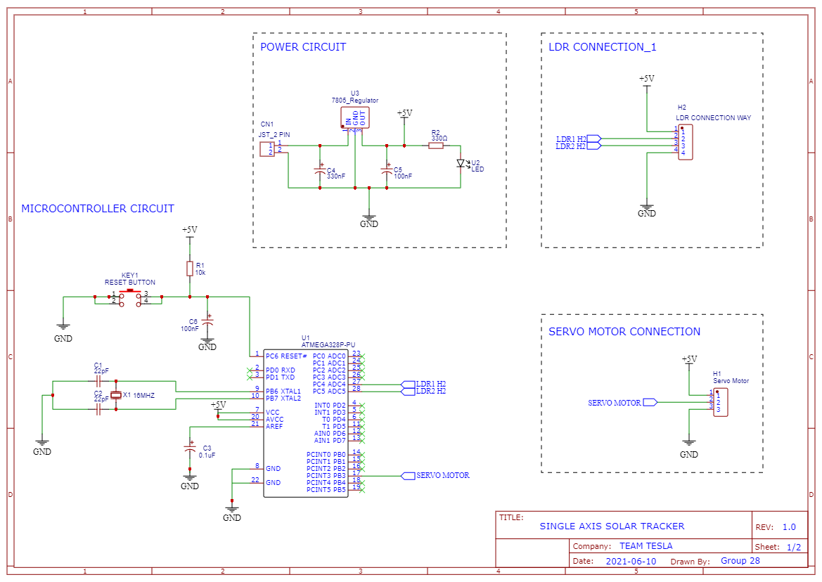
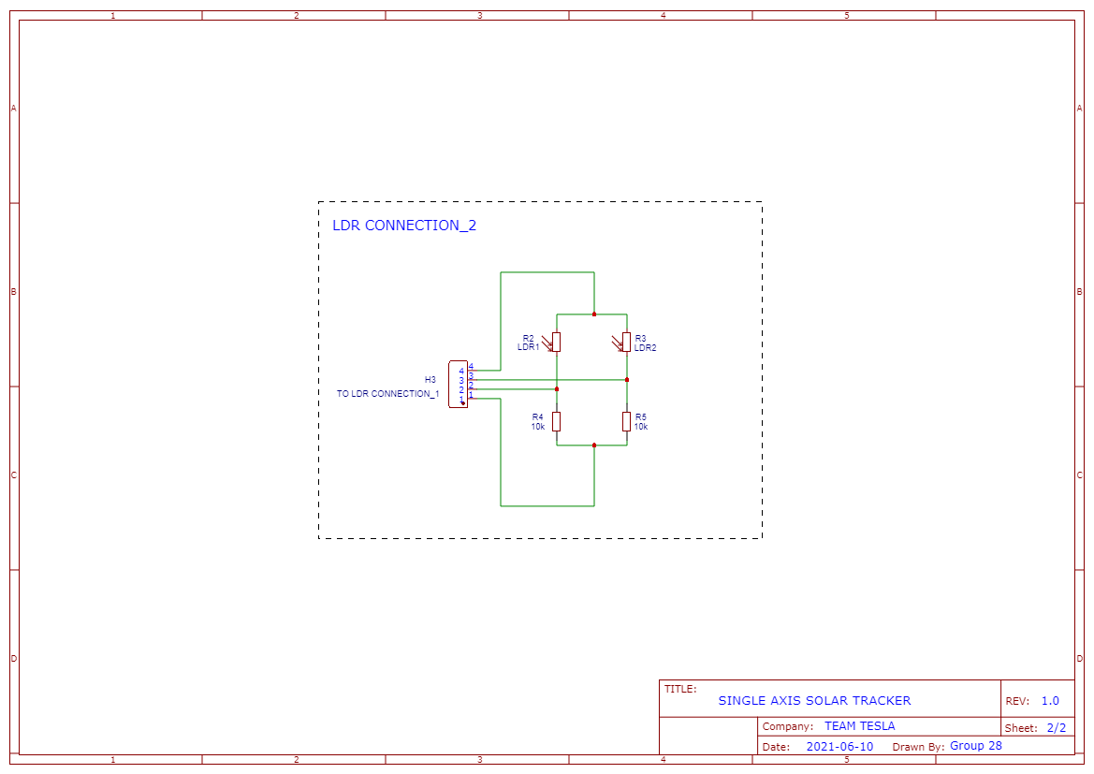
Enclosure Design
Schematic Diagram

Slide 17
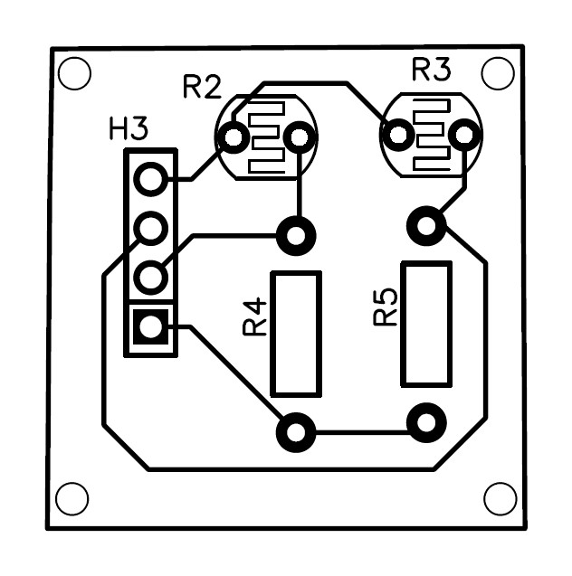
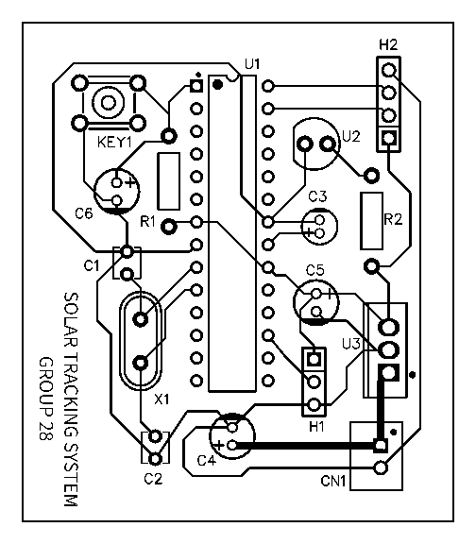
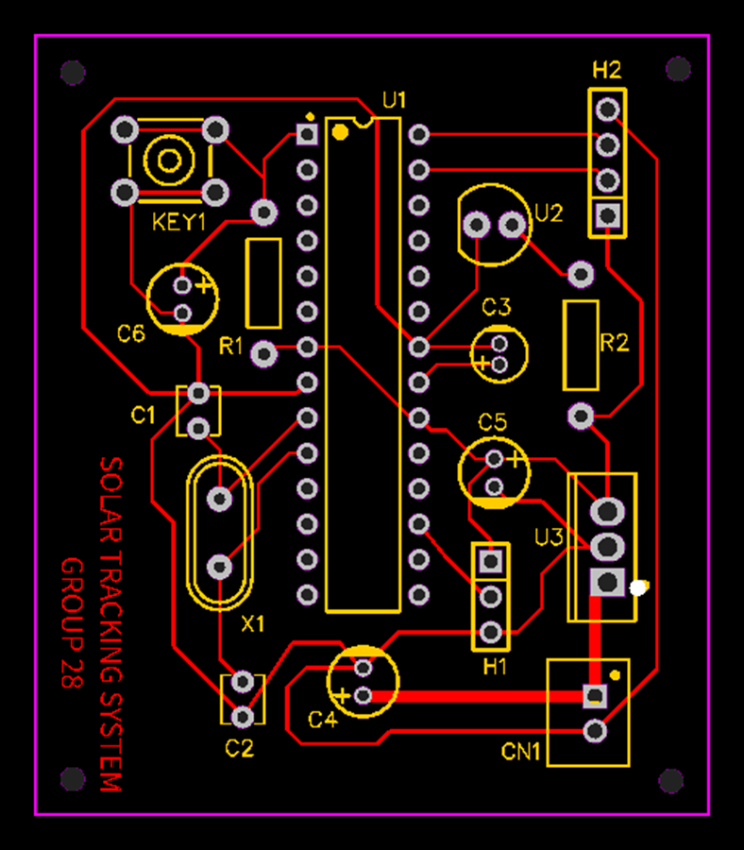
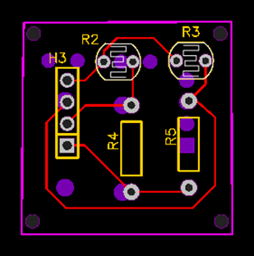
Enclosure Design
PCB Design

Slide 18
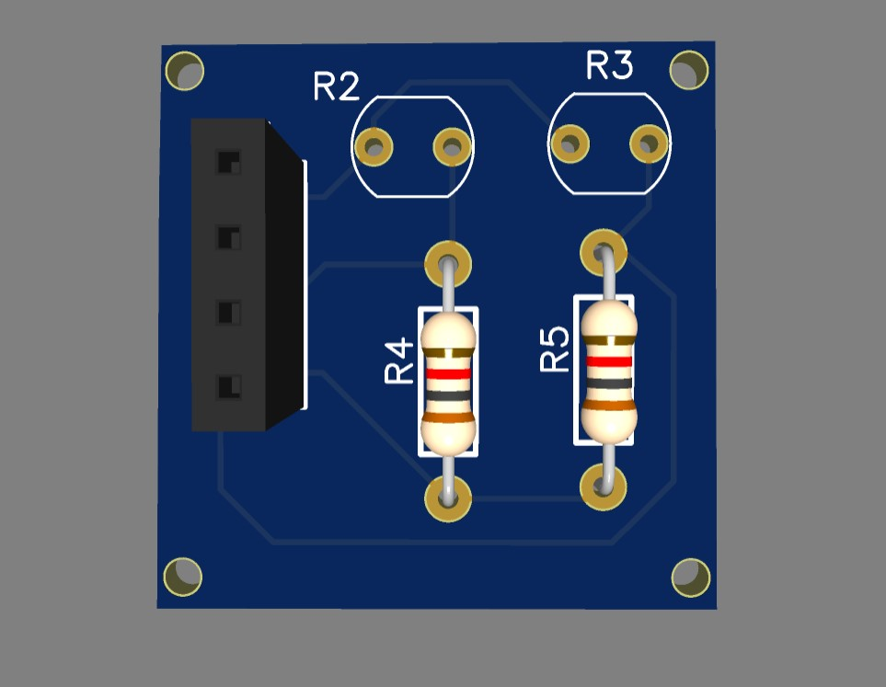
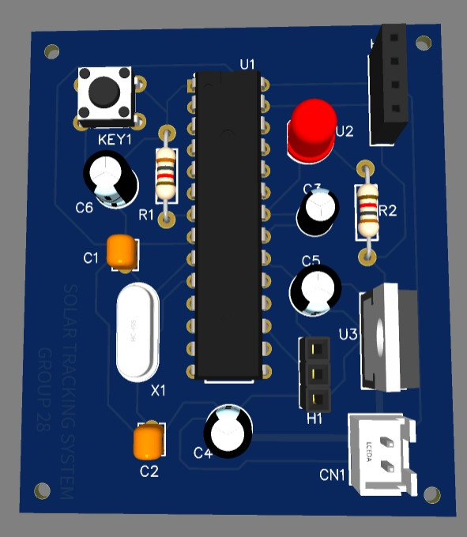
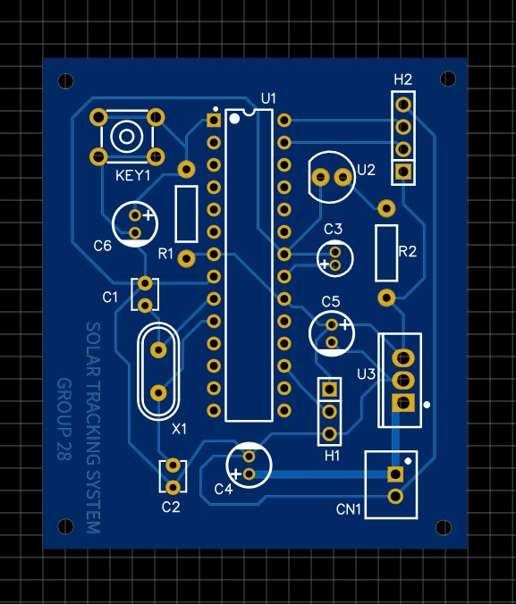
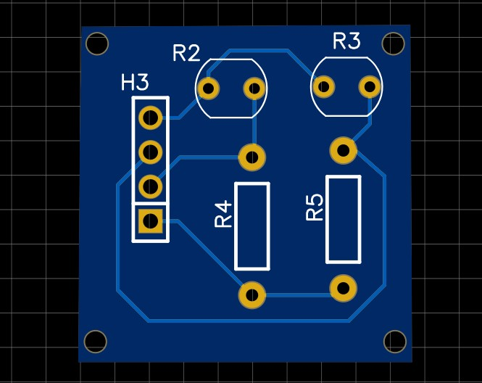
Enclosure Design
PCB Design

Slide 19
Marketing and Sales and Beyond
Product packaging
Maintenance
Reuse/Recycle
Disposal
Use recyclable papers. Cardboards for packaging.
Air Pillows Made of Recycled Materials as an alternative to Styrofoam or bubble wrap.
Battery change ( if used batteries for power up the system).
Recommended to clean solar panel by 6 months.
If any circuit faults we recommend customers to call our hotline for the maintains.
Since, We are using ABS material for enclosure , it can recyclable.
Solar panels are not needed to change for 15 years.( Warranty)
We encourage customers to reuse the system with the minor repairs done by our company without disposal them.
We are planning to buy our disposable product (After 15 years use ) from the customers to dispose them in sustainable way or to recycle them .

Slide 20


Marketing and Sales and Beyond
Marketing and Sales
Posting flyers in social media.
Encourage people to use solar power for garden lighting, domestic power supply as a renewable energy source.
Highlighting advantages about the using solar tracking system rather than using a fixed panels in their houses.
Discounts are given for loyal customers and who are return products for disposal.
Free 1 year service warranty.
Customer only needed to pay the cost for the components that use for repair after the 1 year.
Delivered maintain services by the well skilled electricians and mechanics.

Slide 21
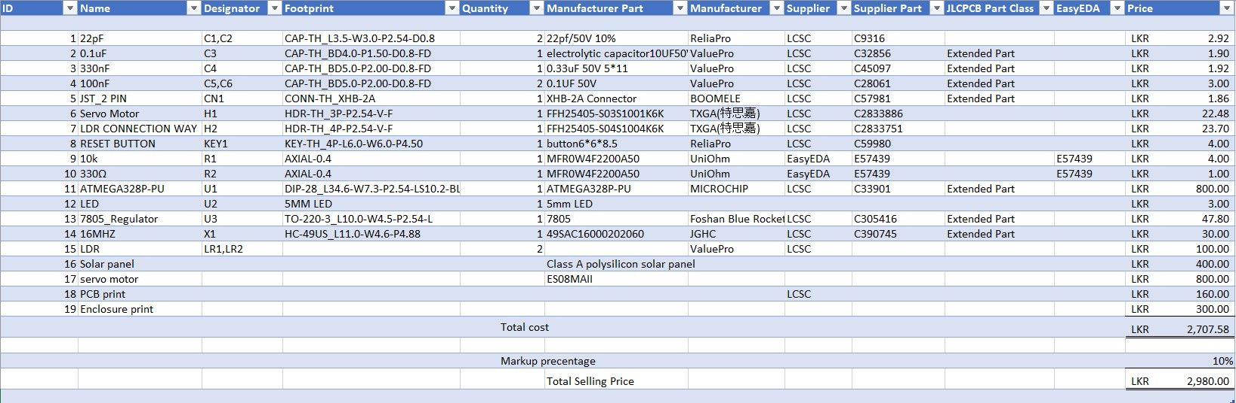
Project Budget
* This is the cost for more than 20 units bulk cost and price.

Slide 22

THANK YOU
GROUP 28
Q/A

